Slide 1
Graph Based Neural Architectures
Tanishq Chaudhary
Mayank Goel
Prajneya Kumar
Shivansh Subramanian

Slide 2
Introduction

Slide 3
Graphs and Neural Networks
A lot of things can be represented as graphs, and in doing so we are able to plot direct relation between two entities and base our calculations on it.
We can think of traditional texts, or images as graphs, but there are more complicated graph structures which find some difficulty being represented by traditional neural network
Say, CNNs, are difficult to use on complex graphs structure due to arbitrary size and no spatial locality

Slide 4
Graphs and Neural Networks
We explore Graph Convolutional Network, a basic Graph based Neural Architecture used to modify the node features as we go through multiple convolutional layers
Then, we explore Attention roughly based on GCNs (called Graph Attention Network, or GAT). This is able to focus on particular edges more, and hence is able to give better results.

Slide 5
Dataset

Slide 6
Dataset and Learning
Depending on the dataset chosen, we may or may not be able to use the traditional training methods
Assuming we have samples of graphs, then we can do a normal 80-20 split where we hold the testing data away from the model, and perform “inductive learning”
Say we have a huge graph, here, we cannot just perform a random split since that would make the graph incomplete. Hence, we show all the nodes to model while training, but back-propagate only on a few of the nodes. This is how we perform “transductive learning”.

Slide 7
Cora Dataset Stats
Cora dataset represents multiple research publications as a network of citations, where 2 publications have an edge if one of them have cited the other (for simplicity, edges are assumed to be non-directional)
Each node has a feature vector assigned to it, based on one-hot encoding of words existing in it or not.
Details about the Dataset:
2708 Nodes (each node is a research paper)
1433 Unique words per document
5278 Edges (citation connections)
7 Classes: Neural Networks, Probabilistic Methods, Genetic Algorithms, Theory, Case Based, Reinforcement Learning and Rule Learning.
Class distribution: { 2: 818, 3: 426, 1: 418, 6: 351, 0: 298, 4: 217, 5: 180 }

Slide 8
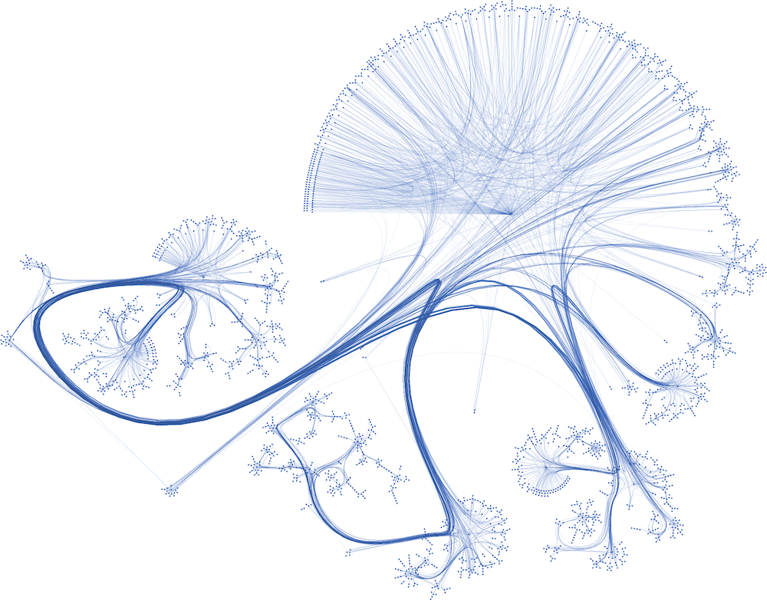
Notes:
@shivu write some cool things here

Slide 9
Understanding
Graphs

Slide 10
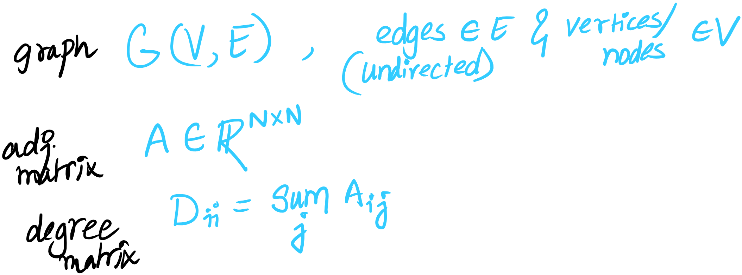

Slide 11
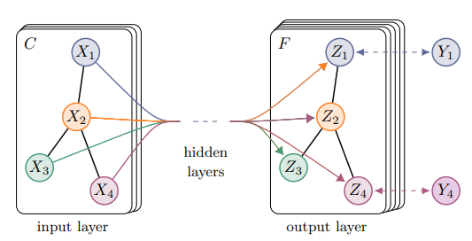
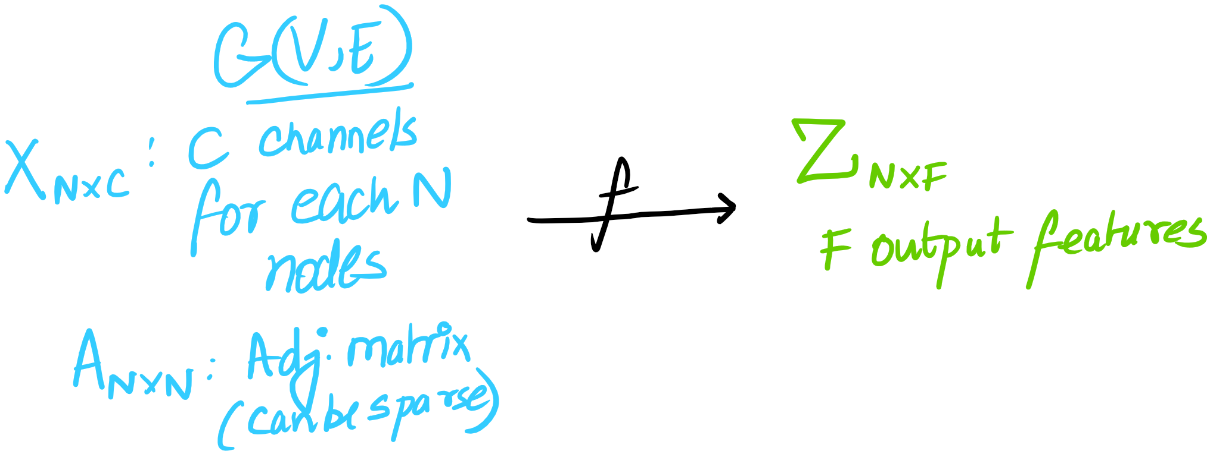

Slide 12
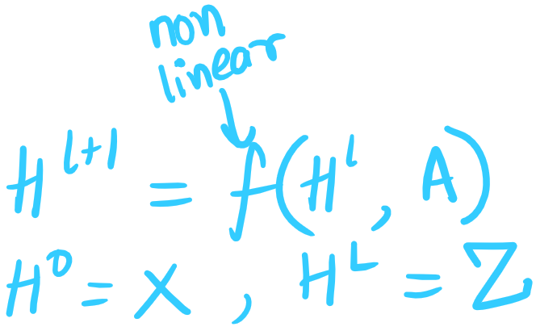

Slide 13
Issues
A will not consider the nodes features itself, unless there are self loops
A can scale the feature vectors arbitrarily.

Slide 14
Fixing the Issues
Adding self loops: A → A + I
Normalizing matrix: A → D^{-0.5}AD^{-0.5}

Slide 15
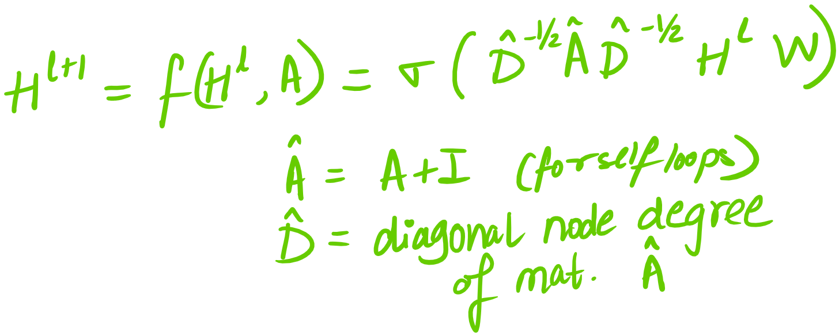

Slide 16
GCN: Implementation

Slide 17
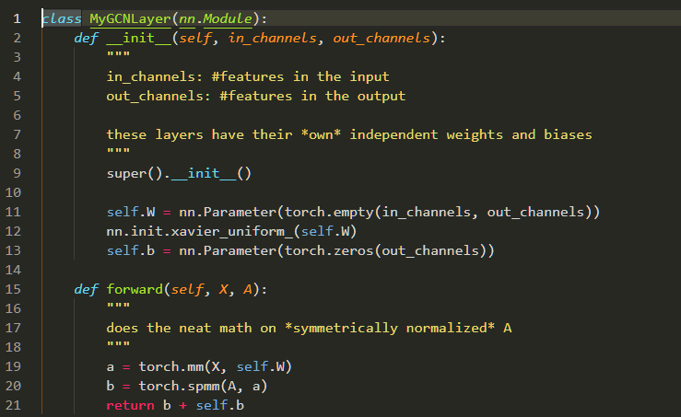

Slide 18
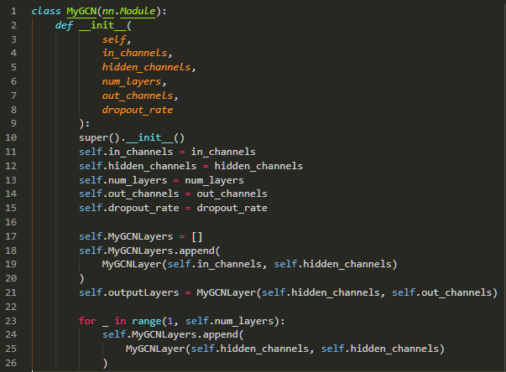

Slide 19
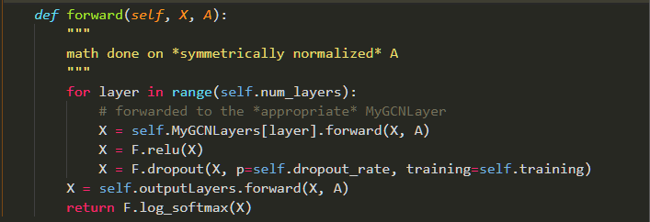

Slide 20
Graph Attention Networks

Slide 21
Attention
Attention is a function represented by a
It is a single layer feed-forward neural network
Takes 2 node features as input, gives attention of the edge as output.

Slide 22
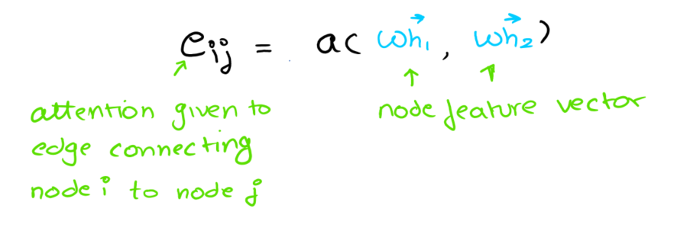

Slide 23
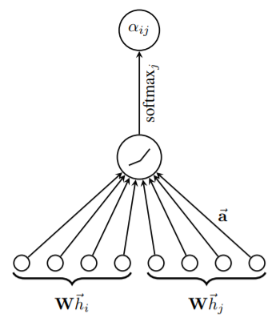
One could also assume a to be just a learnable weight matrix which needs to be multiplied.
Once we get the softmax, we apply LeakyReLU (default parameters) as activation function

Slide 24
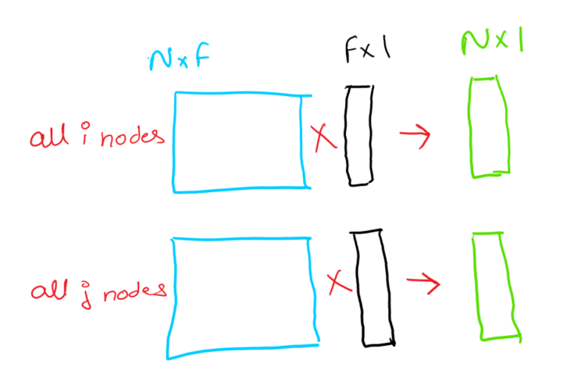

Slide 25
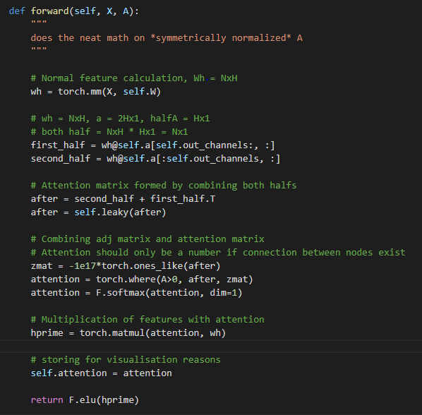
As can be seen in the code:
X: Input features
A: Adjacency matrix
self.a: Attention function, 2*Fx1
We combine output of nodes i and j by adding the output from matrix multiplication together

Slide 26
Results

Slide 27
Hyperparameters
We tried 2 things with both the datasets:
Hyperparameters as mentioned in the paper:
Training Nodes: 140 (20 from each label)
Test Nodes: 1000 (randomly selected)
Epochs: 200
Layers: 2
Hidden Features: 32
Hyperparameters which gave best results:
Training Nodes: 1647 (atmax 250 from each label)
Test Nodes: 1061 (remaining)
Hidden Features: 1-24

Slide 28
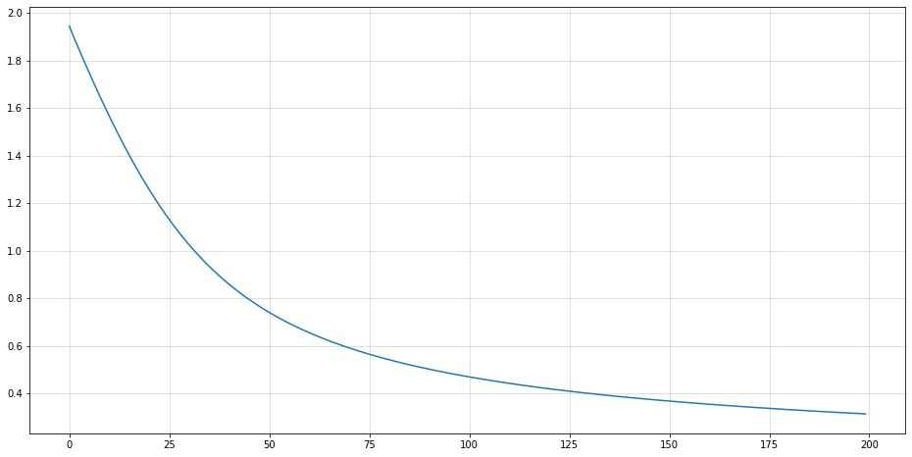
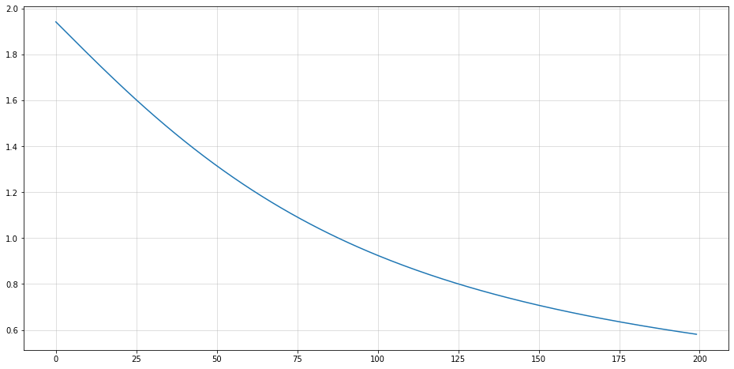
Loss
GCN
GAT

Slide 29
Loss: Interpretations
As we can see, GCN’s loss decreases faster and is lower compared to GAT’s
Possible Explanations:
We observed with our experiments that as the number of layers of GAT increases the loss decreases as well (we could do an experiment on how the loss changes as we increase layers and compare between GCN and GAT)
Another explanation is that since initially a matrix is randomized, probably GAT would perform better as we increase the number of epochs
We observe that test accuracy for GCN: 76.5%, and GAT: 82.38%, hence it could also be that GCN overfits hence gives lesser loss.

Slide 30
Understanding Attention

Slide 31

Attention
We compare the difference between the first layer of the model and the last layer (first & second layer in our case)
2708x2708 (node by node) attention matrix is not easily understood, so we take the first 42 nodes for each class → 42x42 matrix
We expect to see a high weightage on the node itself and some
<0
=0
>0

Slide 32
Attention Insights
Initially, attention matrix is randomized, hence we see that GAT’s losses start higher as compared to GCNs
Highest change (whether negative or positive) occur in self edges, which means that the nodes most effecting a node’s class is most probably itself
As seen in the images of attention plotted for same labels, all attention matrices are symmetric in nature
A possible explanation for change in colour might be that node_i is more affected by node_j as compared to node_j by node_i.

Slide 33
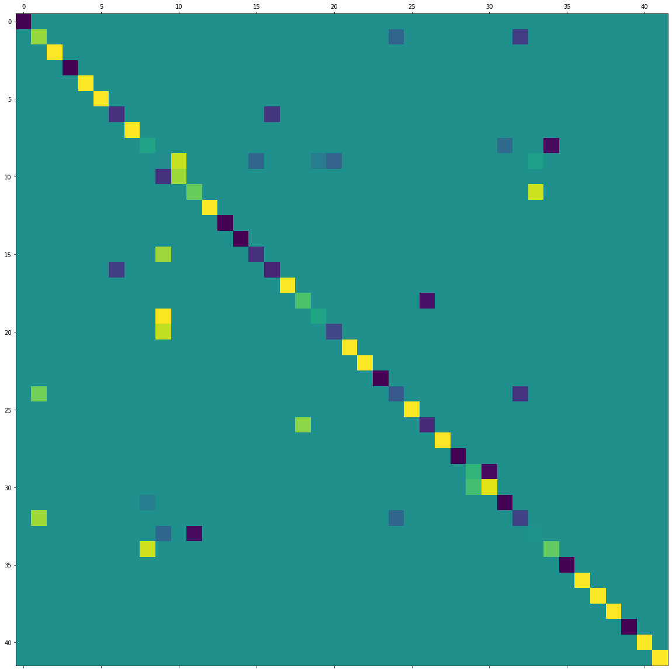
Class 0

Slide 34
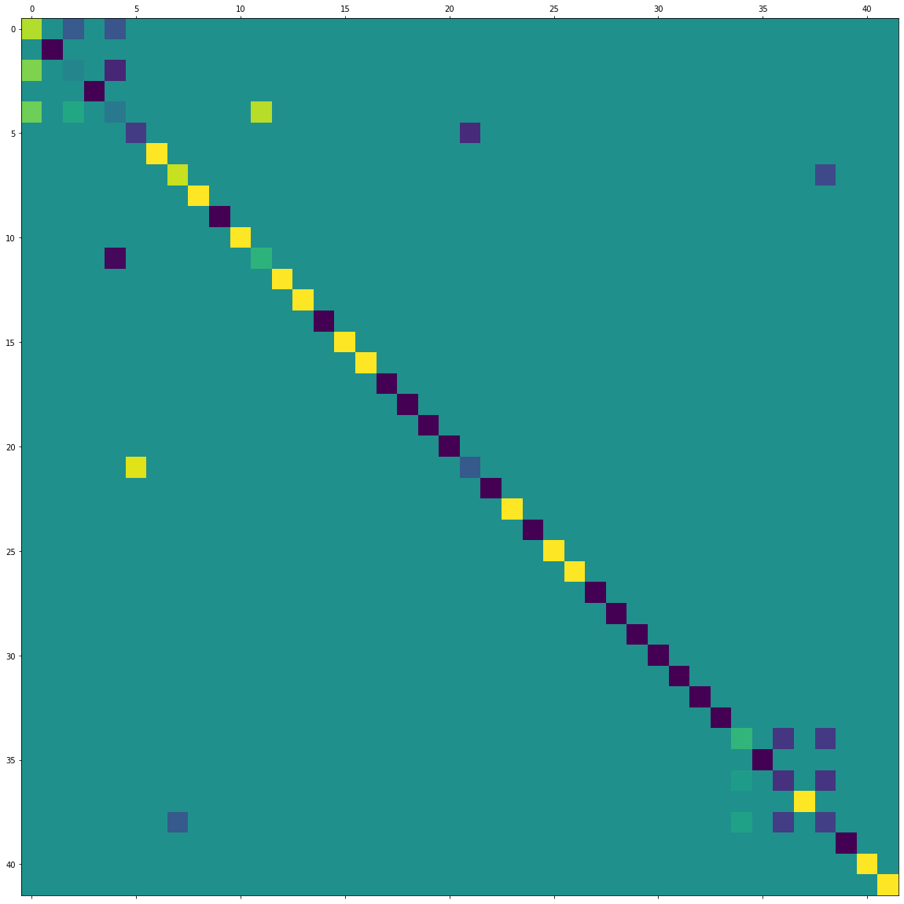
Class 2

Slide 35
Experimental Analysis

Slide 36
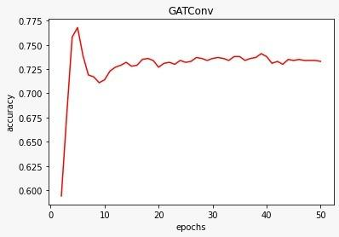
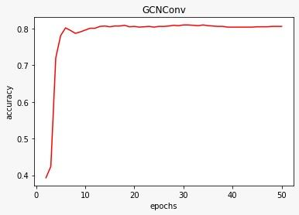

Slide 37
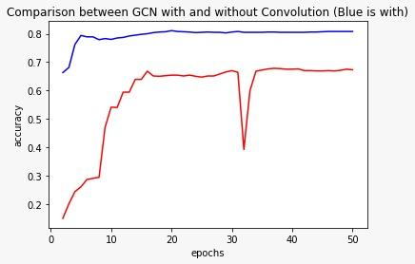
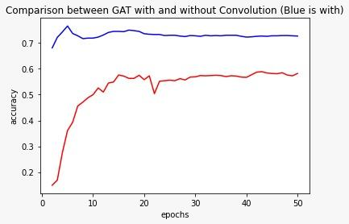

Slide 38
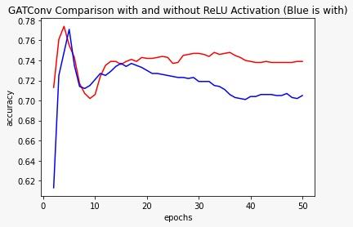
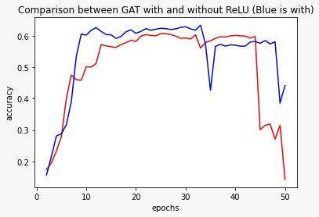
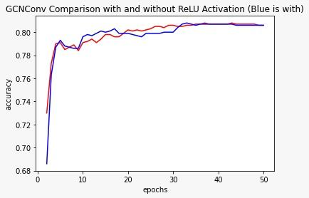

Slide 39
Applications

Slide 40
Application - the TASK at hand
Initially, deciding upon an NLP Task like Text Classification, Relation Extraction
Visualising attention: main focus of SMAI Project
Word Embedding Prediction
Goal of Model != Aim of Model Analysis

Slide 41
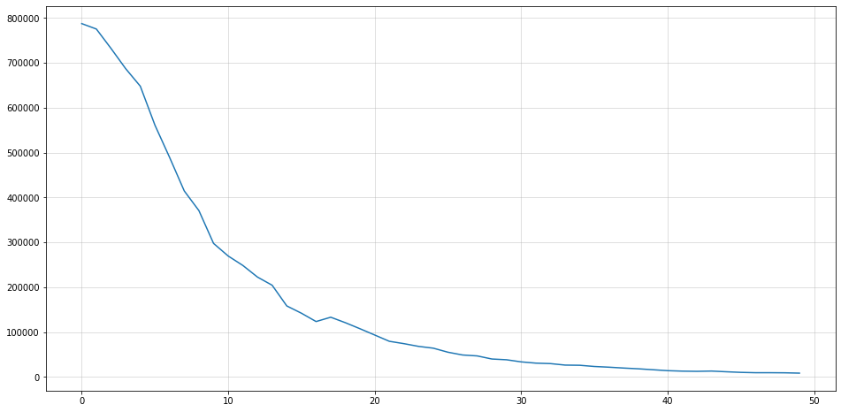
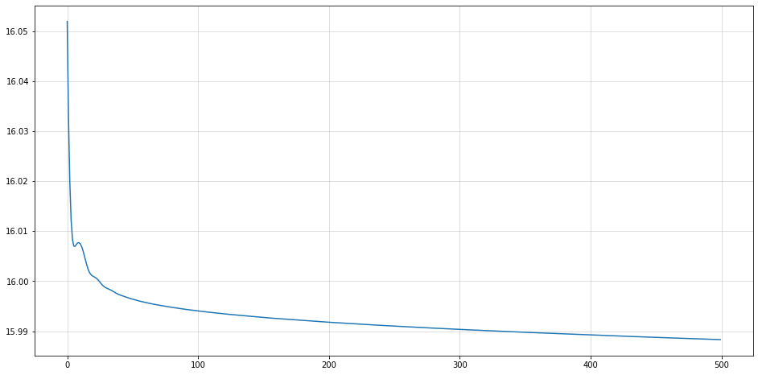
Applications - GCN vs GAT (loss)
Loss
Epochs
Epochs

Slide 42
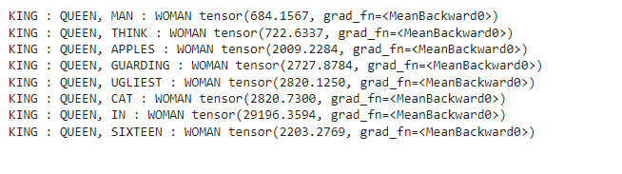
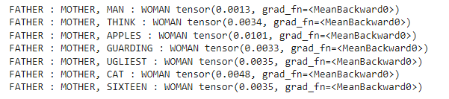
Applications - GCN vs GAT (word embeddings)

Slide 43
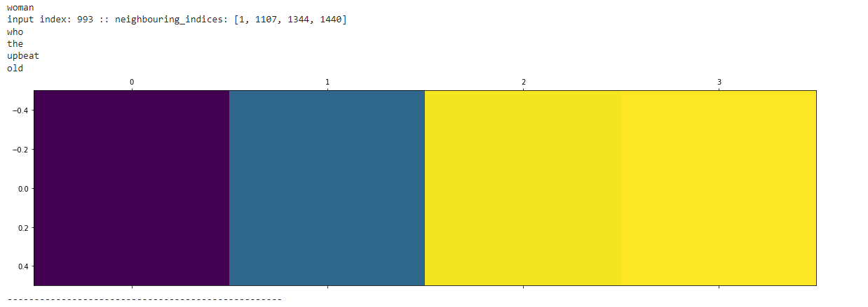
Applications - Outperforming of GAT (Attention)

Slide 44
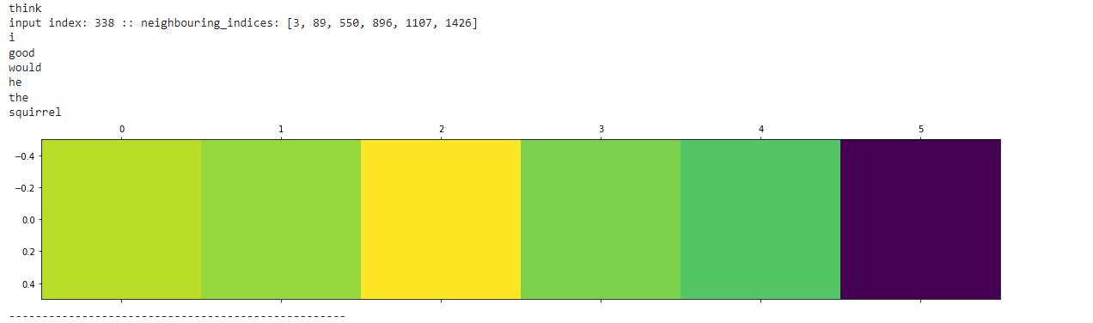
Applications - Outperforming of GAT (Attention)

Slide 45
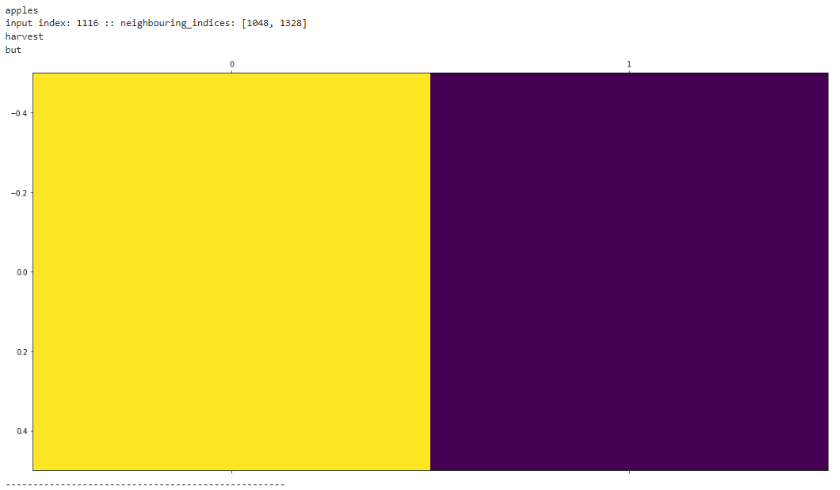
Applications - Outperforming of GAT (Attention)

Slide 46
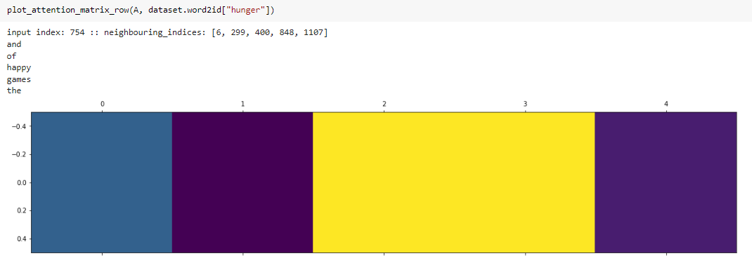
Applications - Outperforming of GAT (Attention)

Slide 47
Discuss

Slide 48
BACKUP SECTION

Slide 49
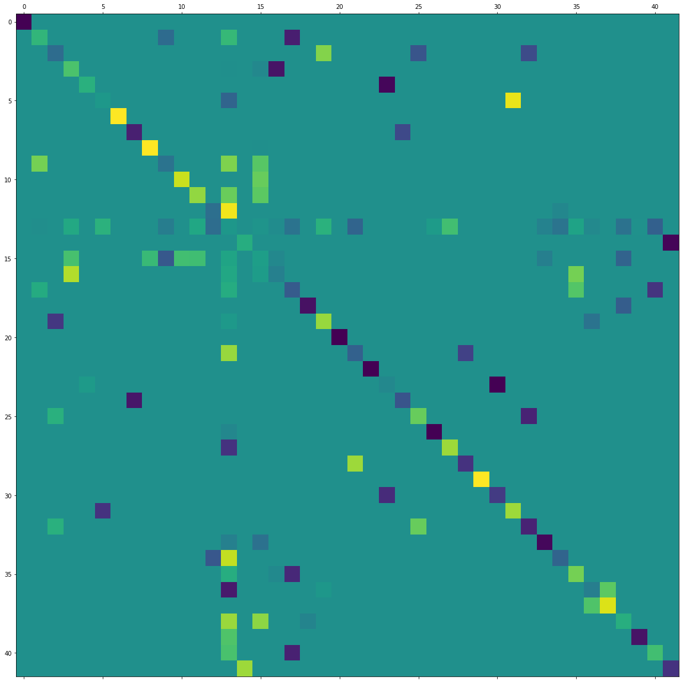
Class 1

Slide 50
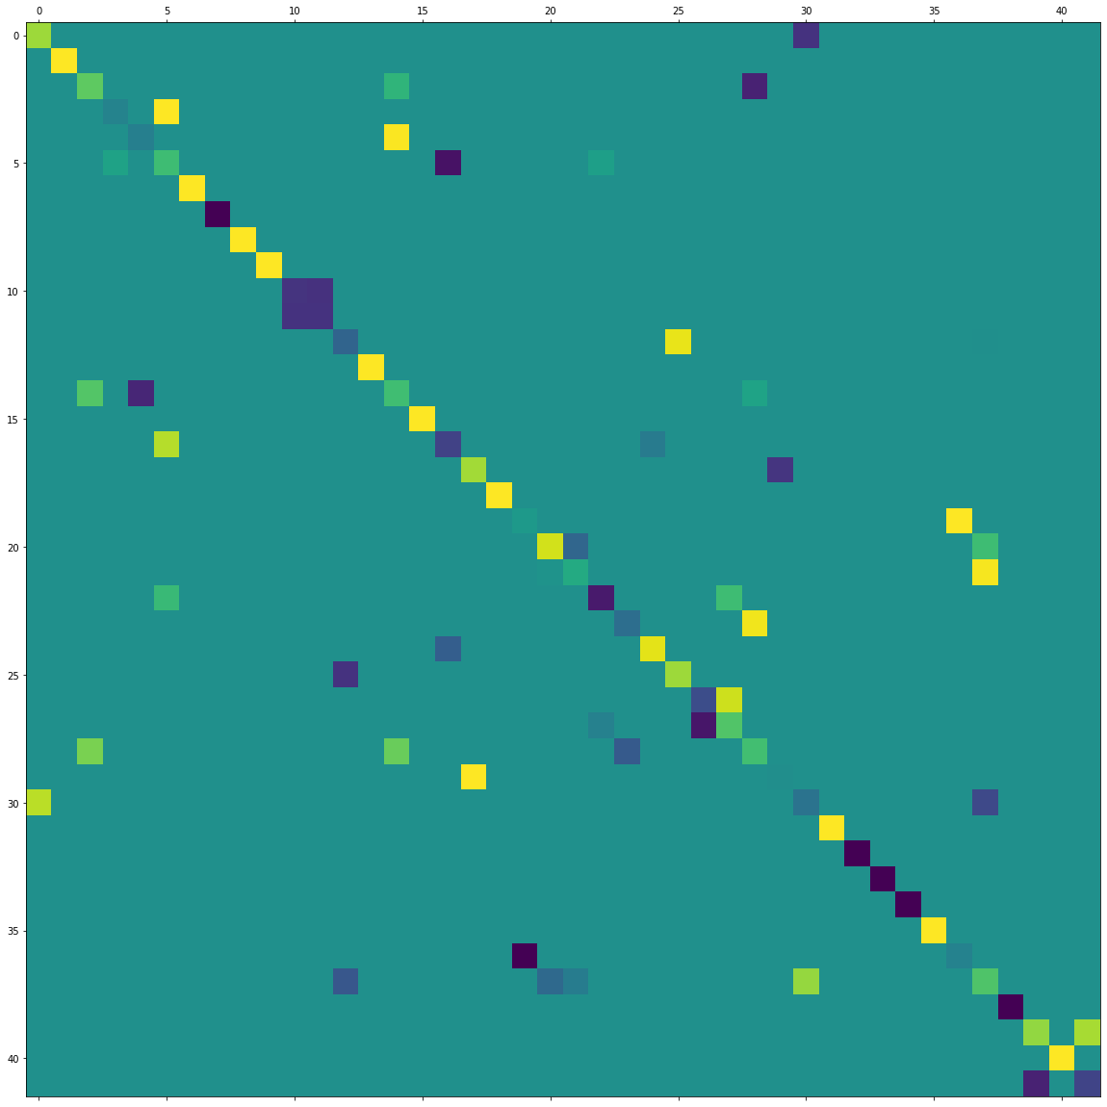
Class 3

Slide 51
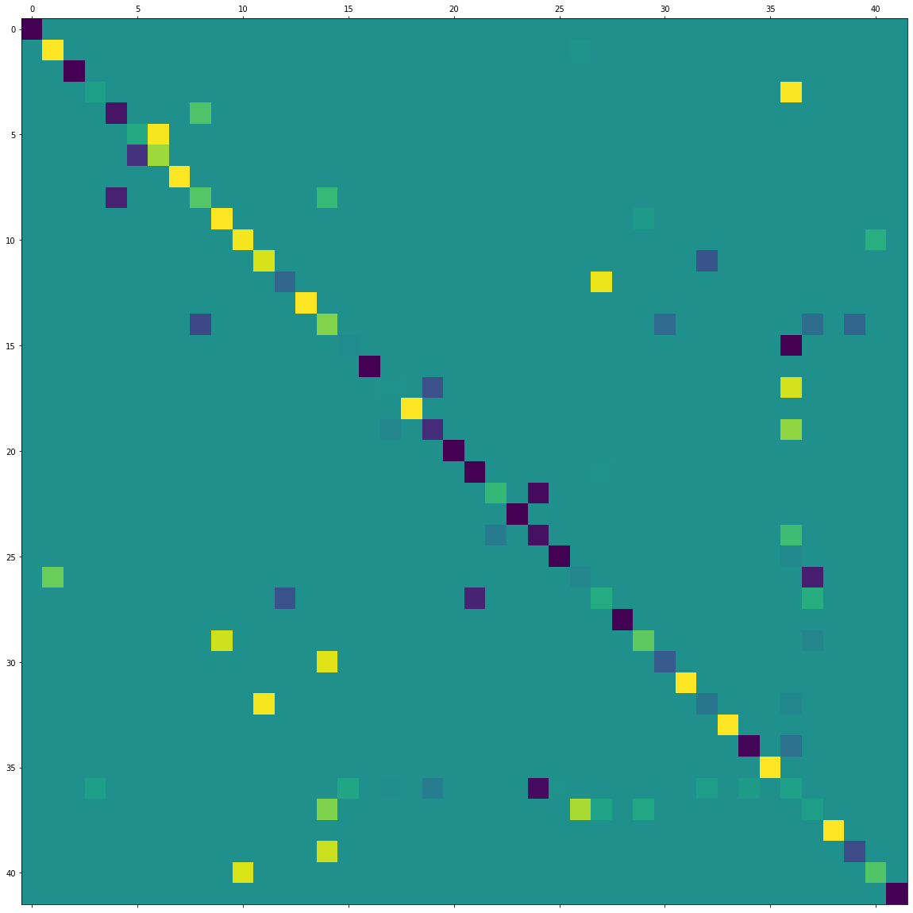
Class 4

Slide 52
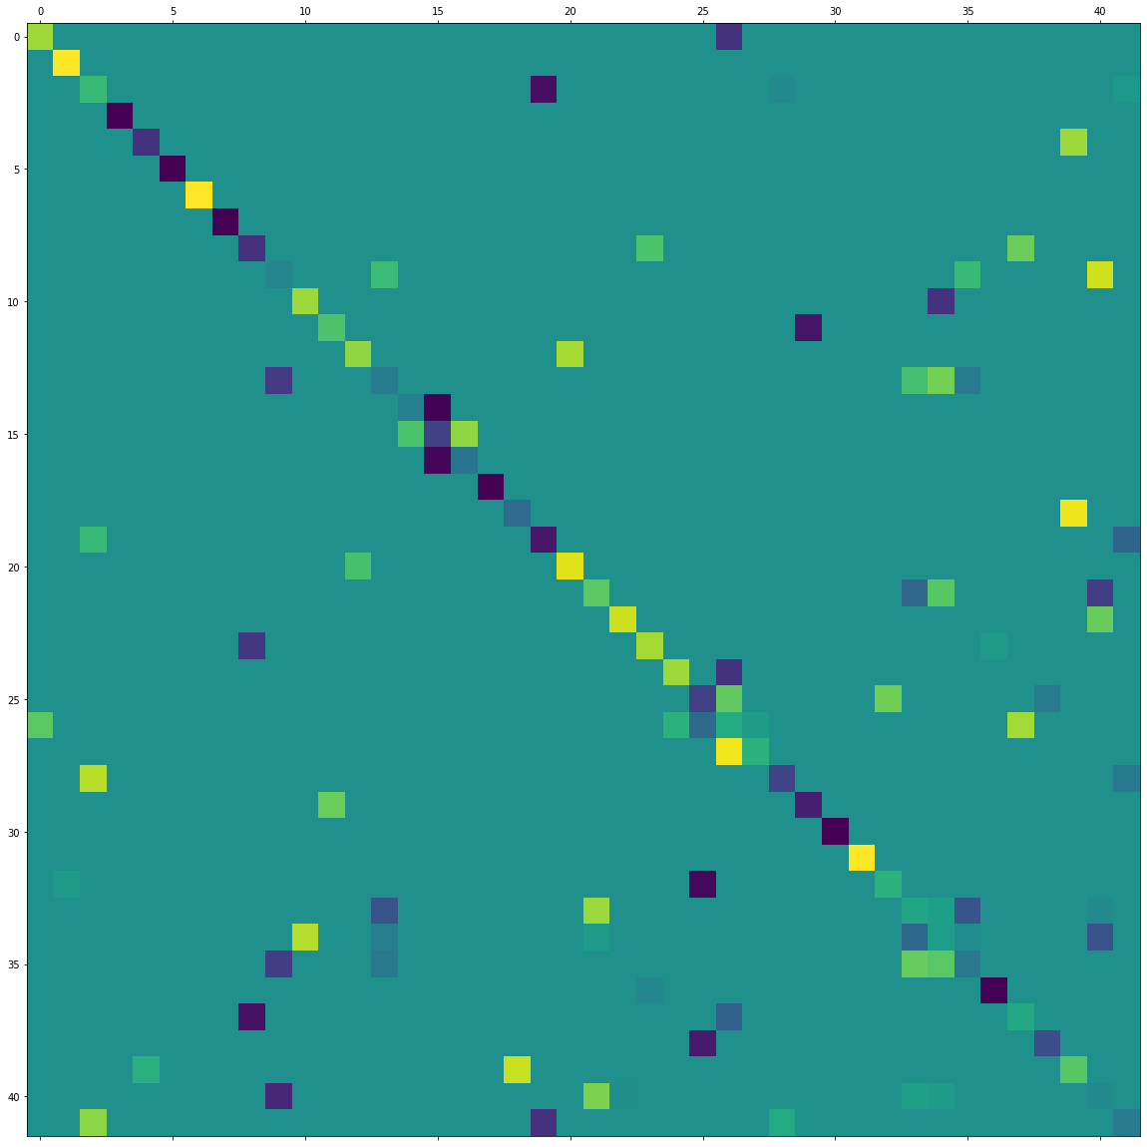
Class 5

Slide 53
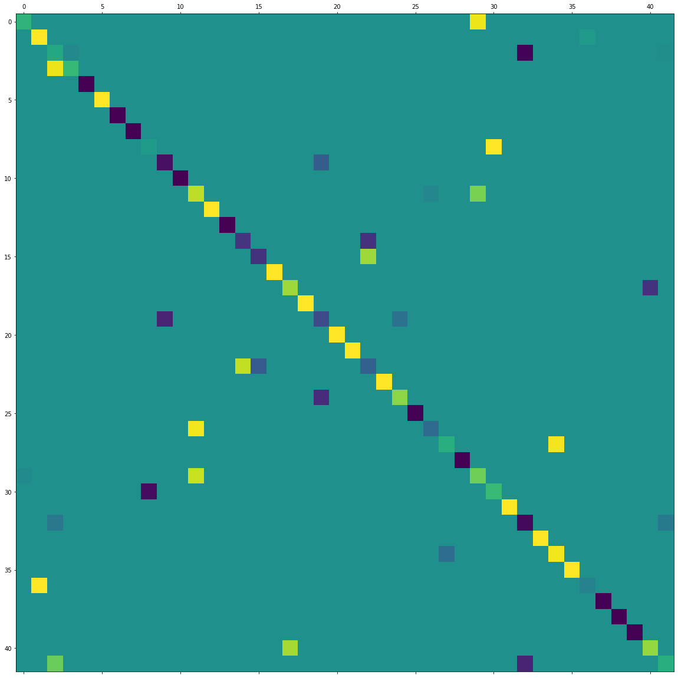
Class 6

